Slide 1

TulaBy
Web And Mobile Application

Slide 2
Project Supervisor
Dr.Rania Ramadan

Slide 3


Team Work
Hesham Mohamed Ahmed
Mostafa Maher Ahmed
Mostafa Adel ElSayed
Mostafa Abdelhakeem Mohamed
Fouad Tharwat Hanna
Hadeer Elsayed Ahmed
Mohamed Ahmed Noureldeen
Janet Gad Elseed Attia

Slide 4

Content
Problem
Solution
work plan
Diagrams
Tools
Design
conclusion

Slide 5

what’s the problem?
Traditional paper-based attendance tracking has several drawbacks:
Time-consuming process: Professors take valuable class time in manually taking attendance.
.
Inaccuracy: Paper-based records are susceptible to errors or omissions.
Lack of efficiency: Managing and storing paper attendance sheets is cumbersome and inefficient.
Accessibility: Students encounter challenges accessing their attendance records or verifying their attendance.

Slide 6

what’s the Solution?
Dynamic Attendance Registration: Unique codes for each session; students register attendance.
.
Real-time Updates: Professors monitor attendance instantly.
Automated Record-keeping: Attendance records are stored digitally.
Accessibility: Students access attendance records easily.

Slide 7

Work Plan
A
Define the problem
B
Research
C
Determine the target audience

Slide 8
Work Plan
D
Create a user-centered design
E
Develop the frontend
F
Build the backend

Slide 9
Work Plan
G
Test the application
H
Continuously update and maintain
I
Evaluate the impact

Slide 10

Design

Slide 11
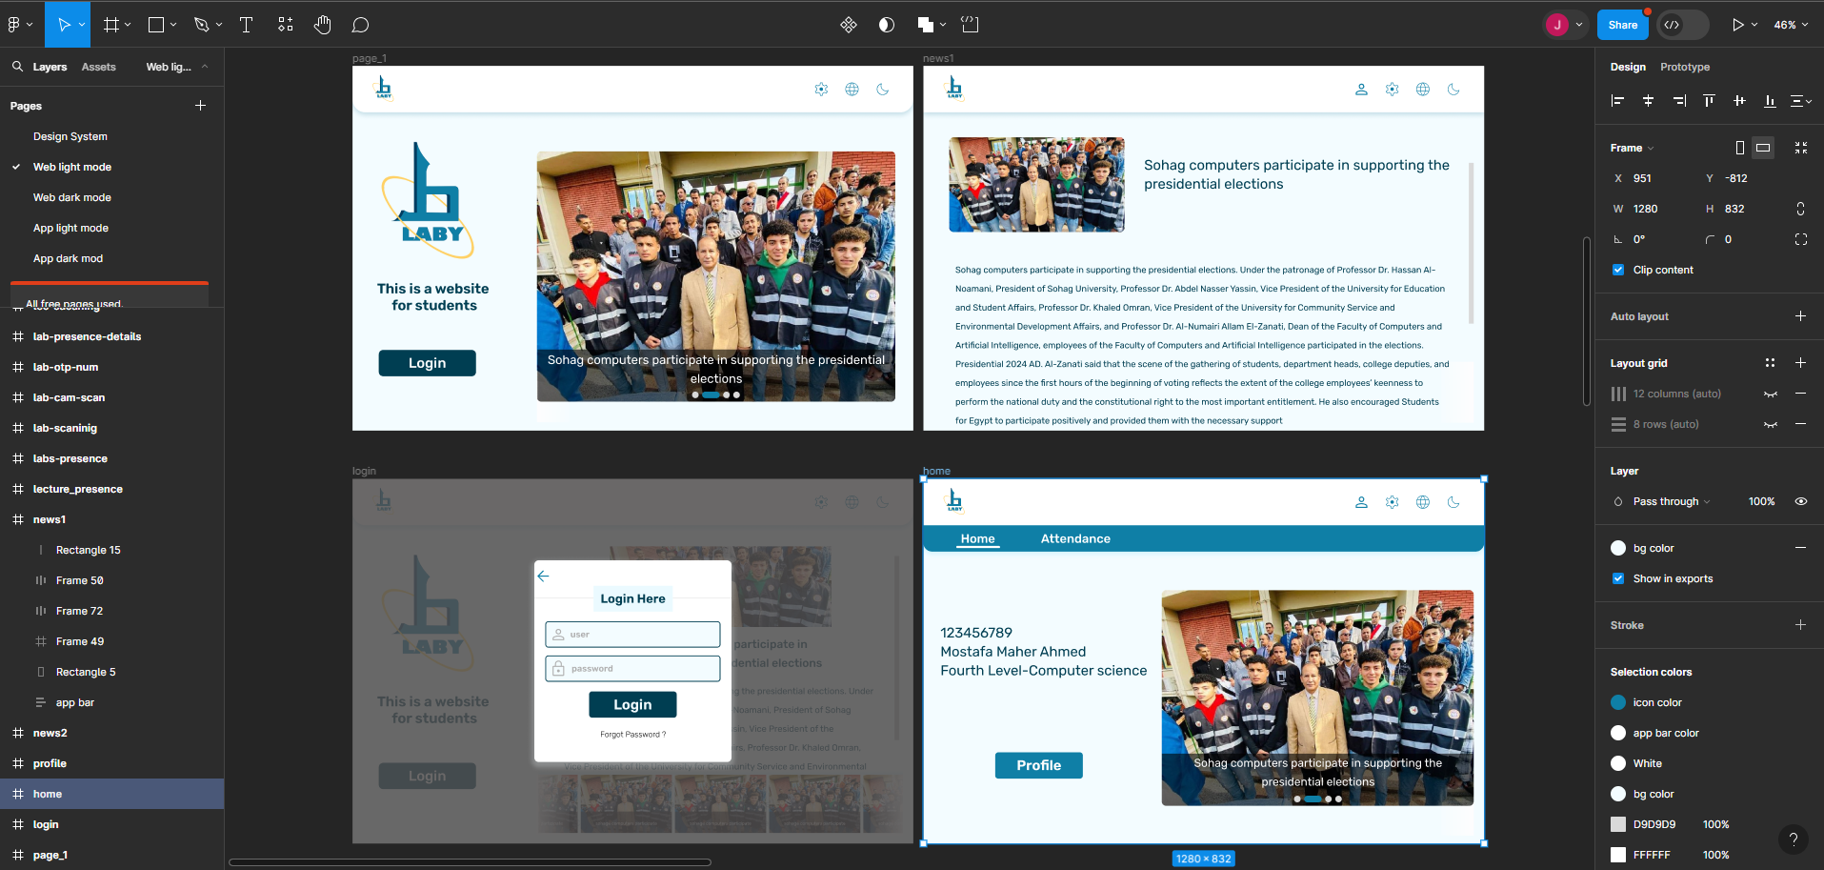

Slide 12
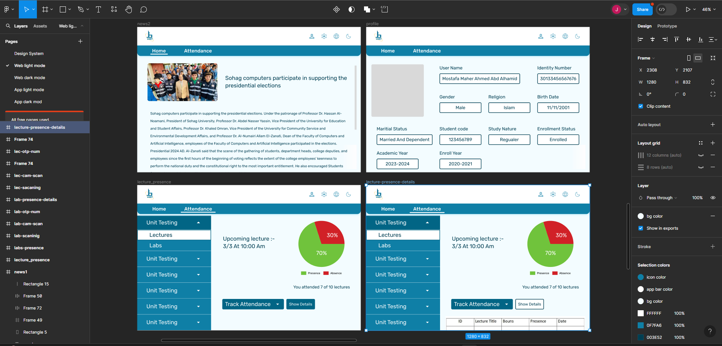

Slide 13
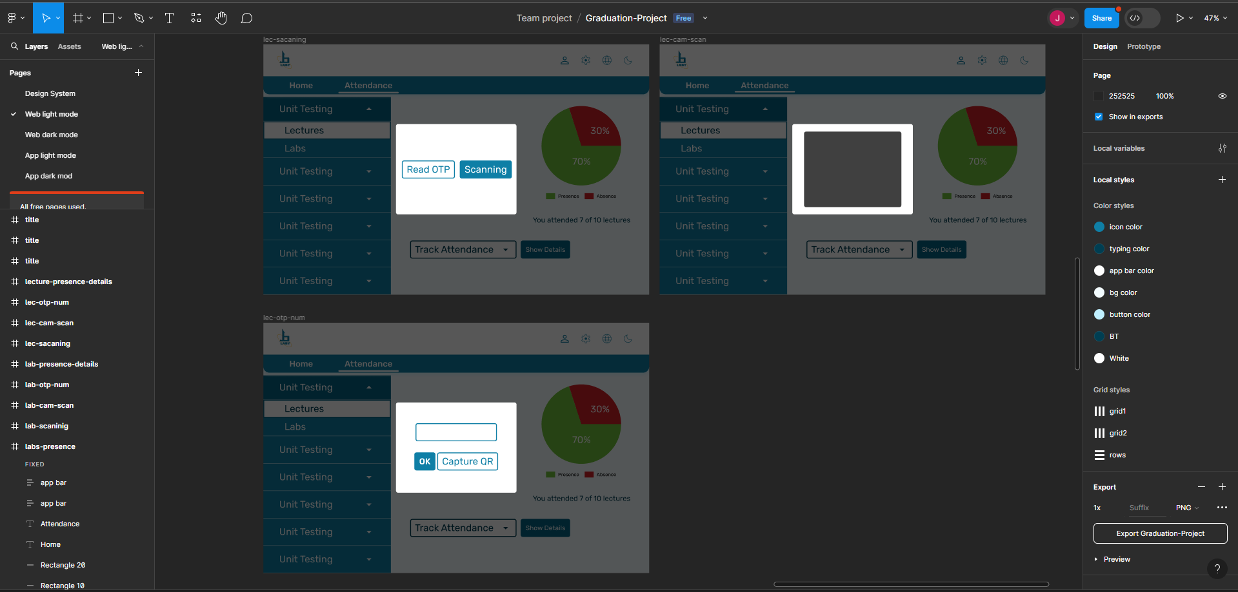

Slide 14
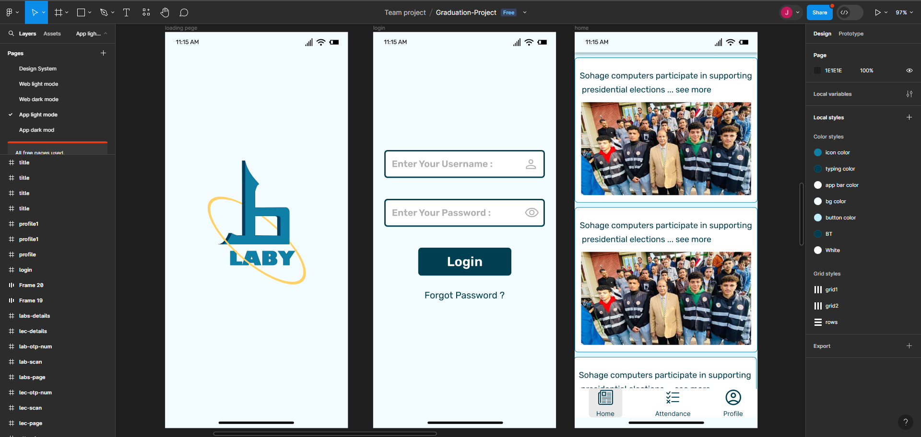

Slide 15
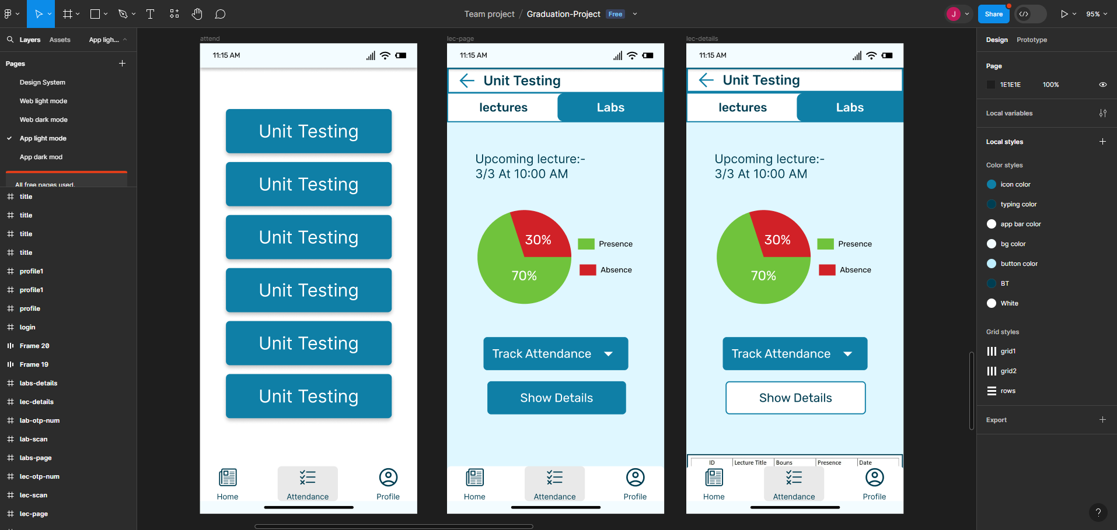

Slide 16
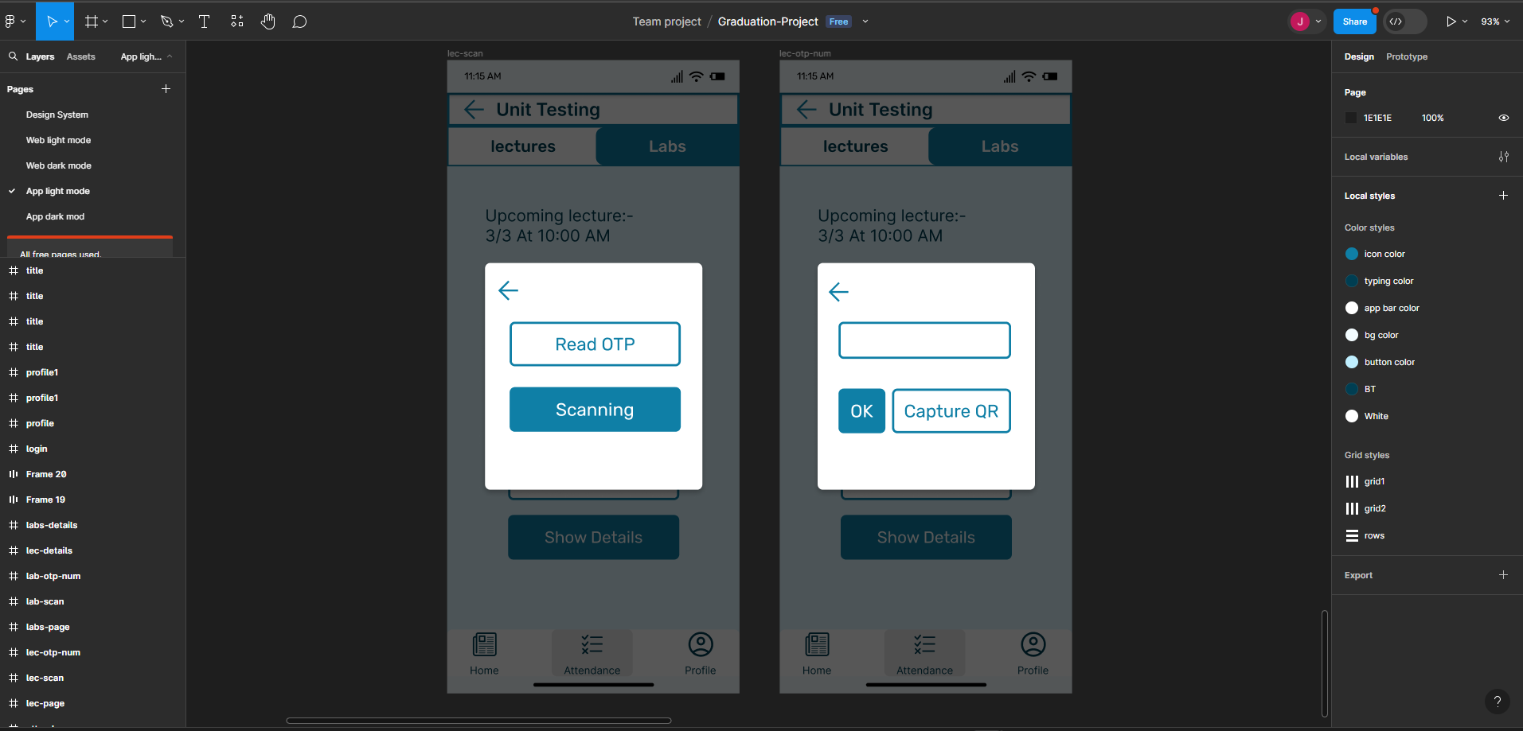

Slide 17
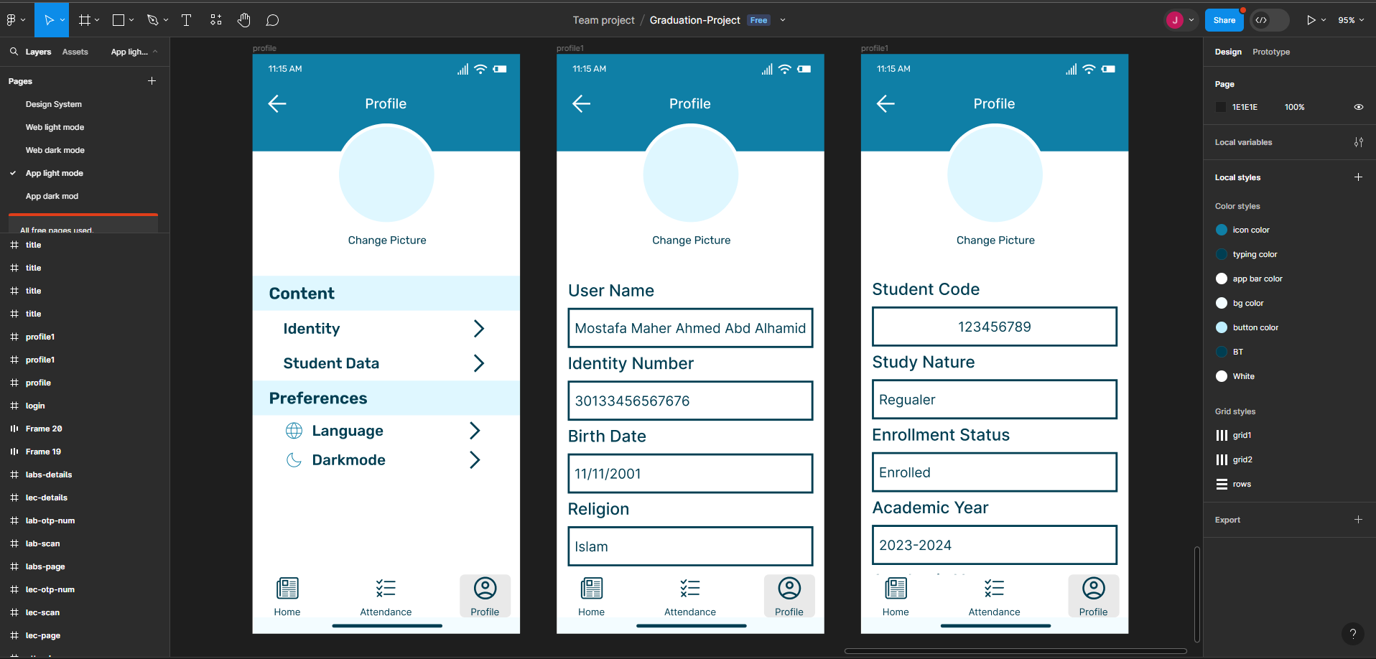

Slide 18

Use case
Diagram
DFD
ERD

Slide 19
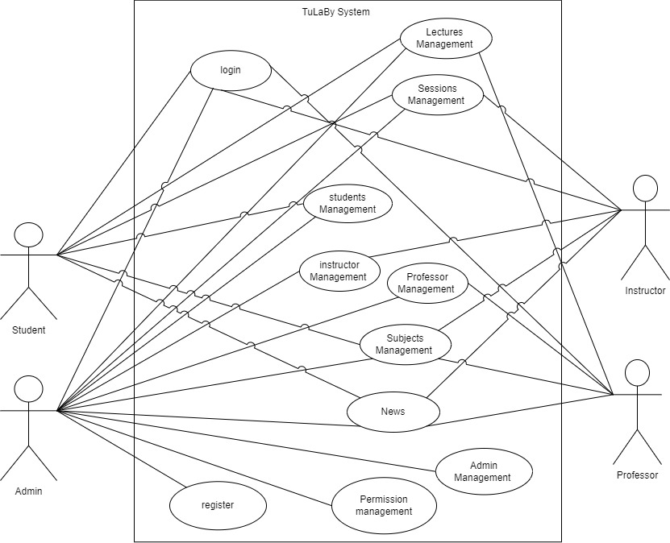
Use case :

Slide 20
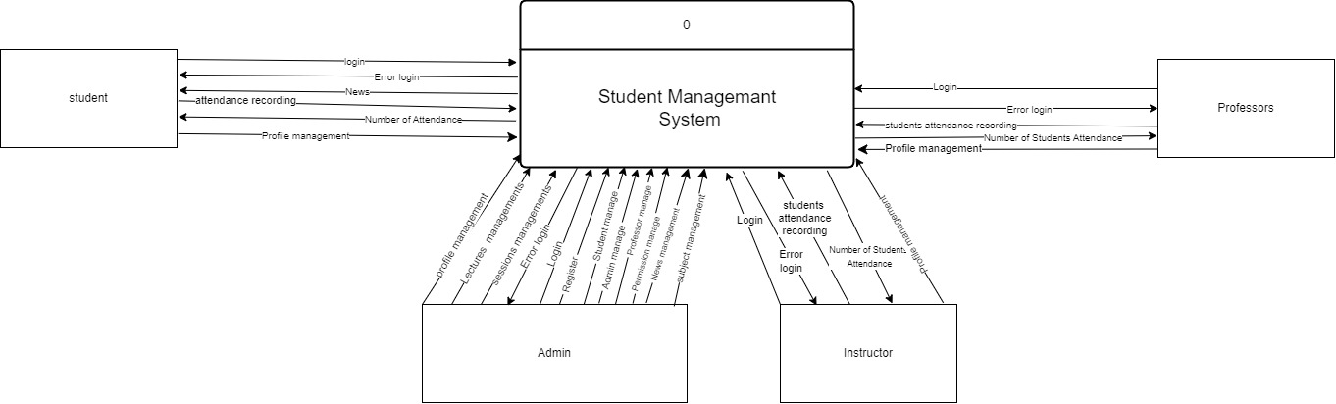
Context level :

Slide 21
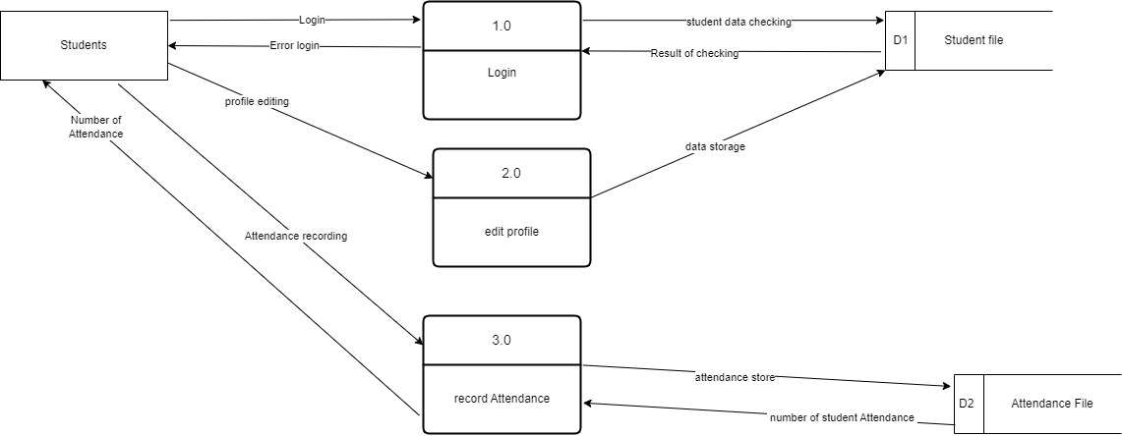
Level 0 :
Student

Slide 22
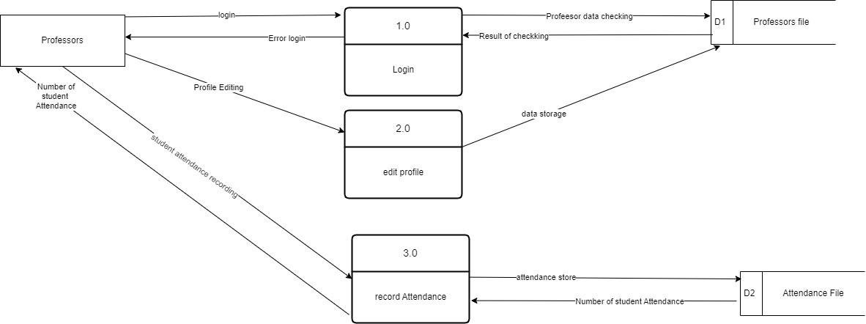
Level 0 :
Professor

Slide 23
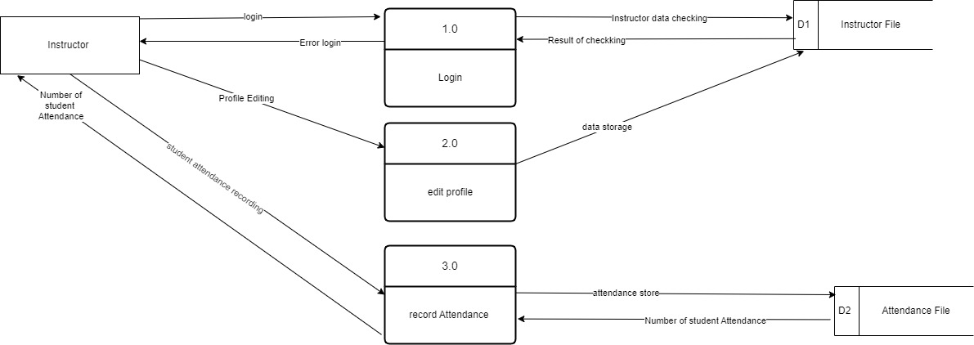
Level 0 :
Instructor

Slide 24
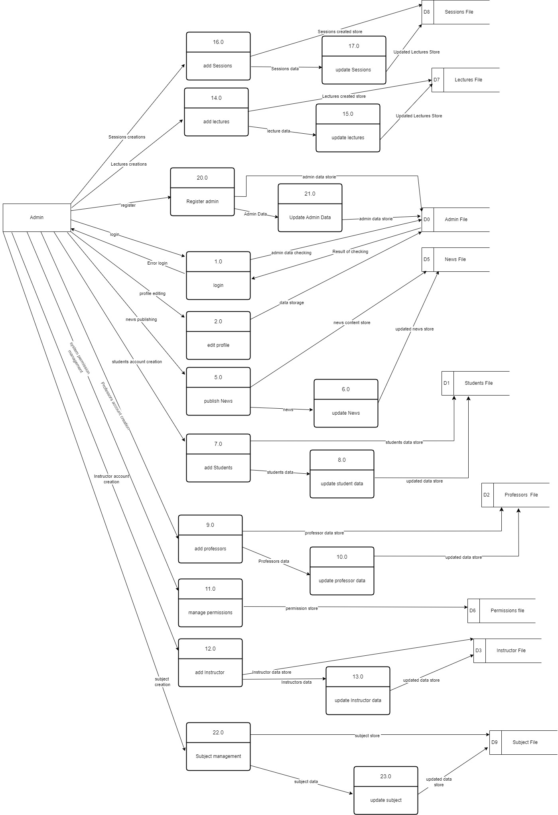
Level 0 :
Admin

Slide 25
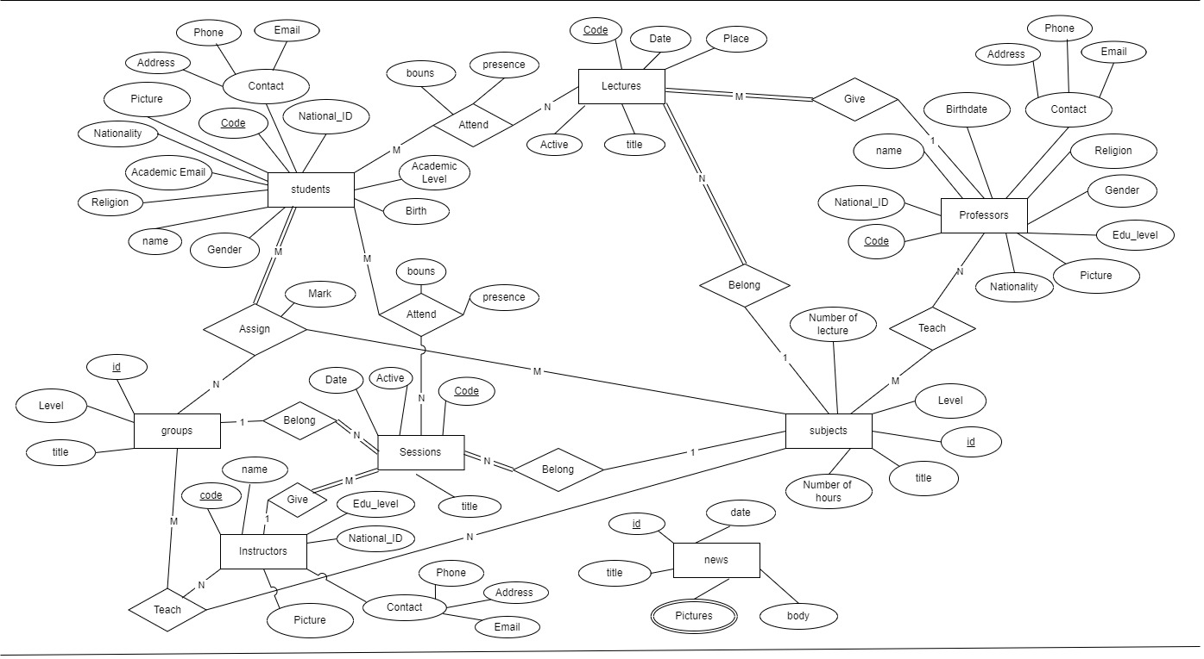
ERD :

Slide 26
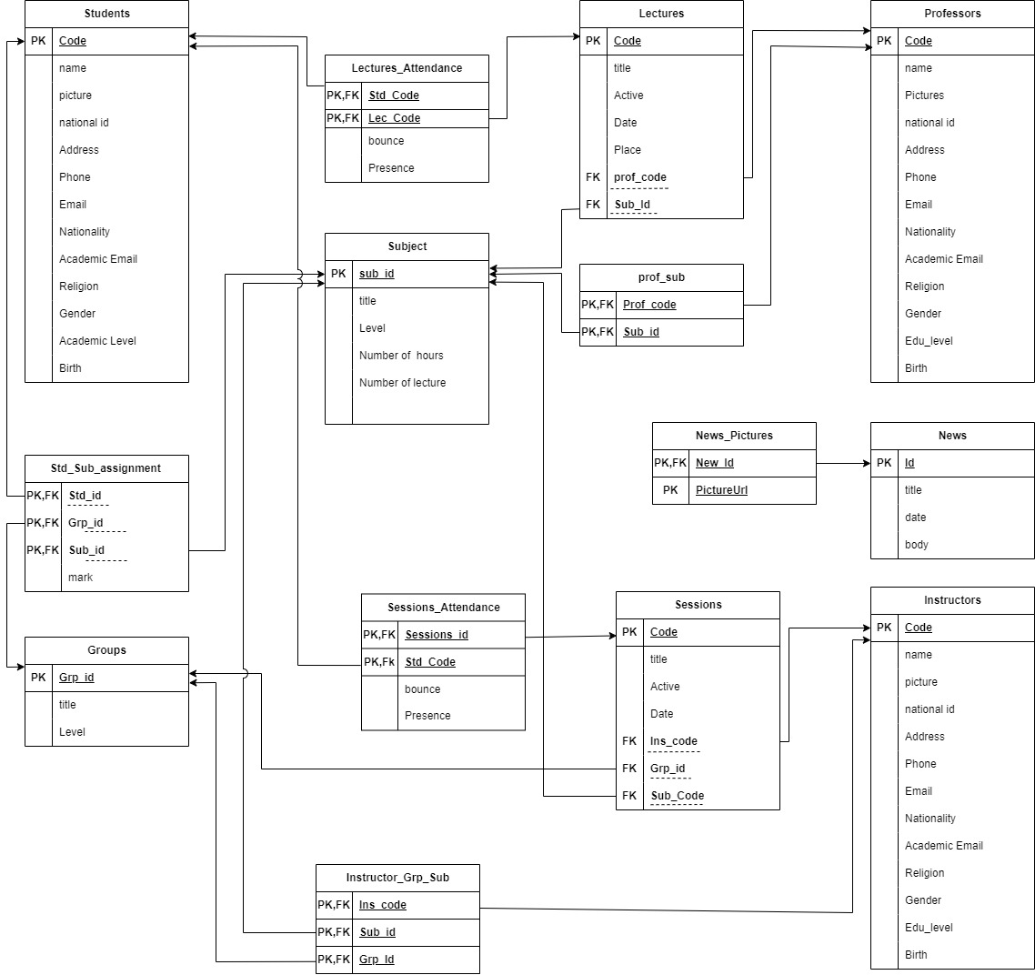
Mapping-schema :

Slide 27
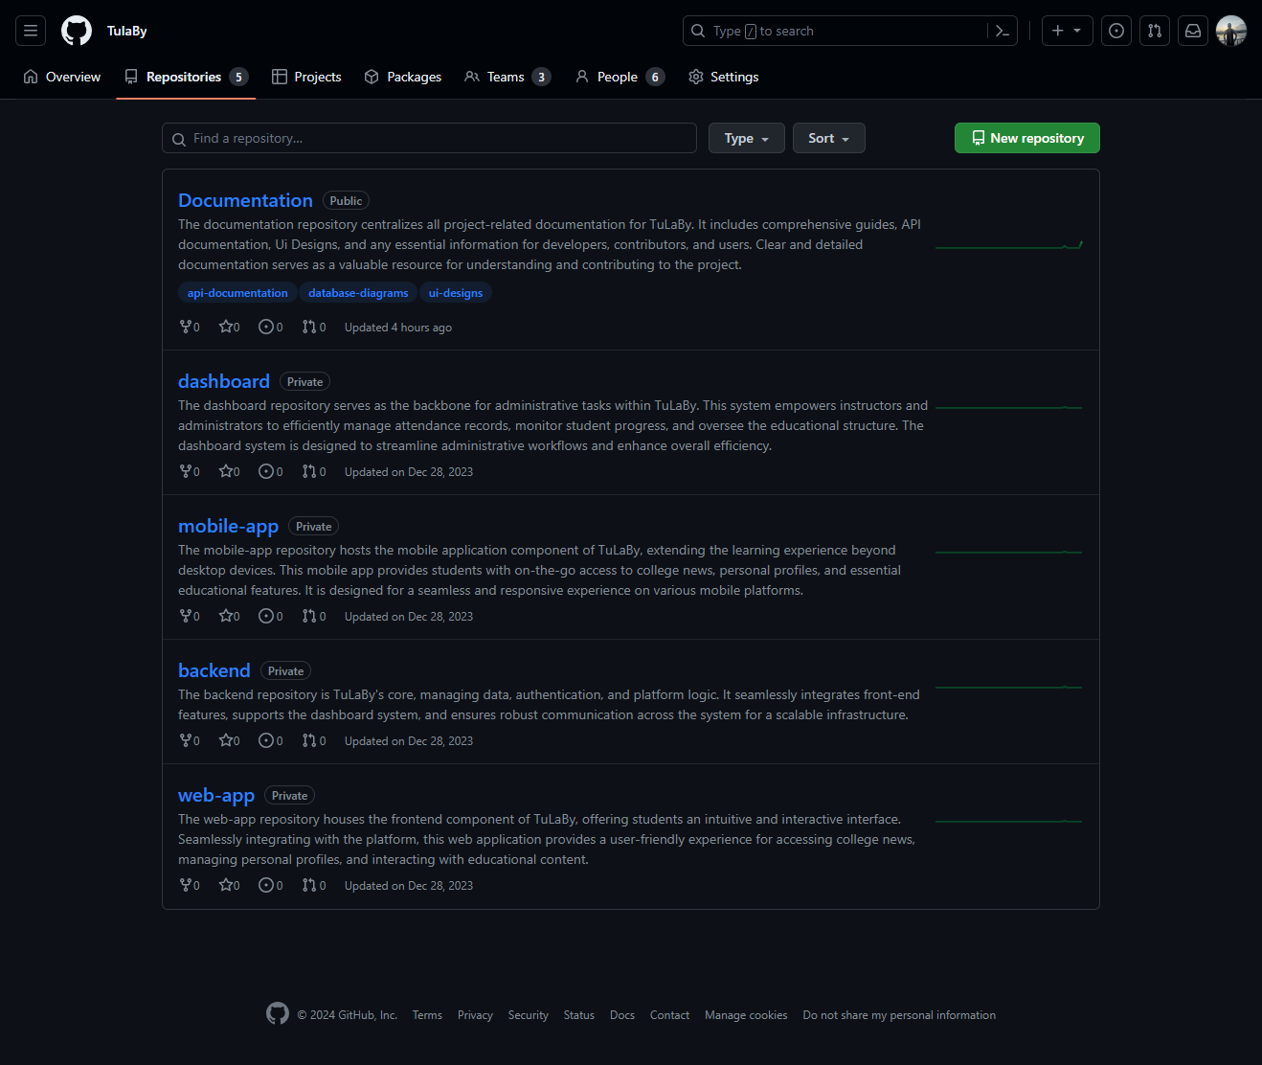

Slide 28
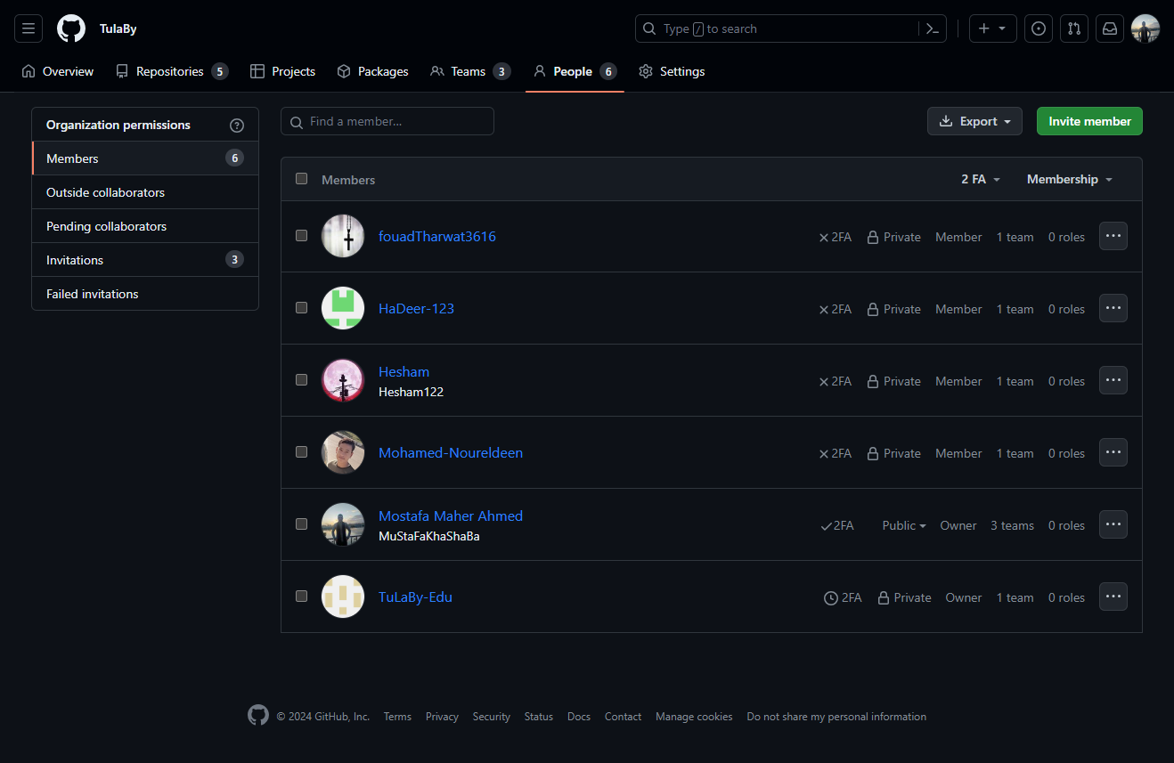

Slide 29
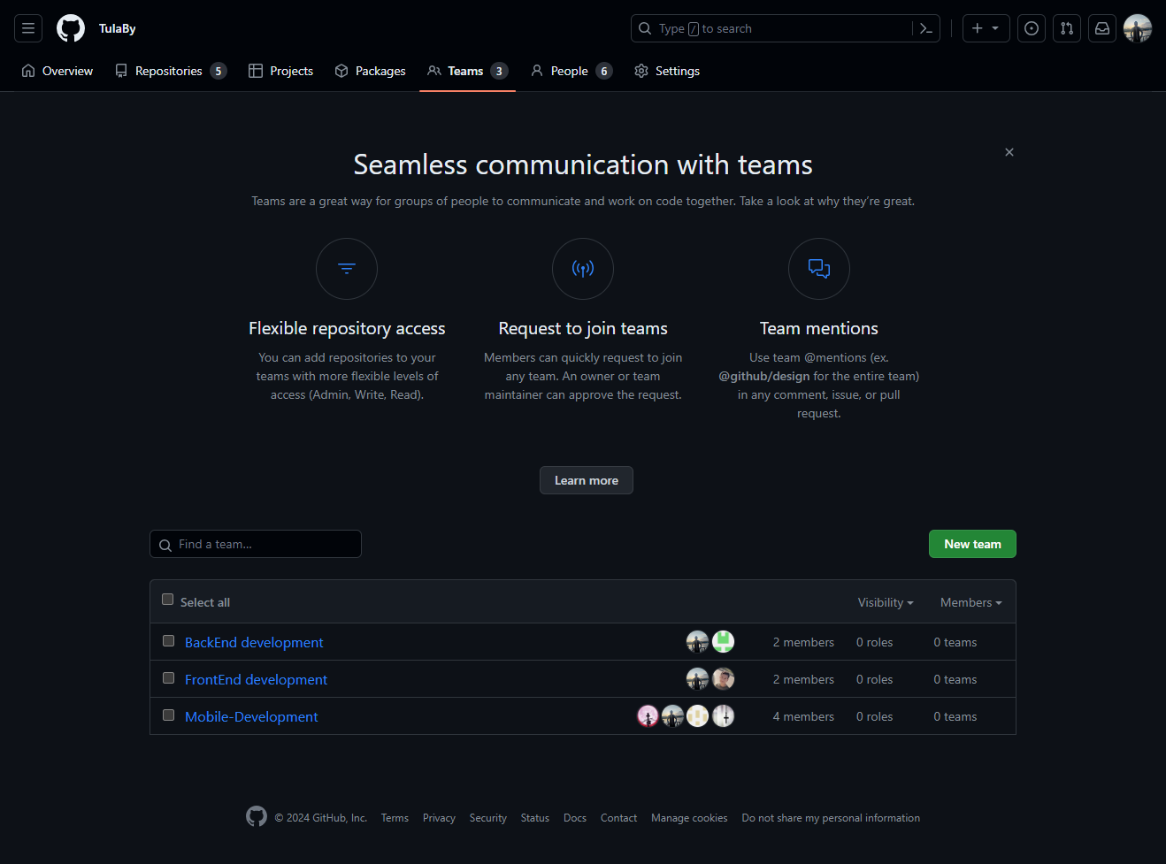

Slide 30
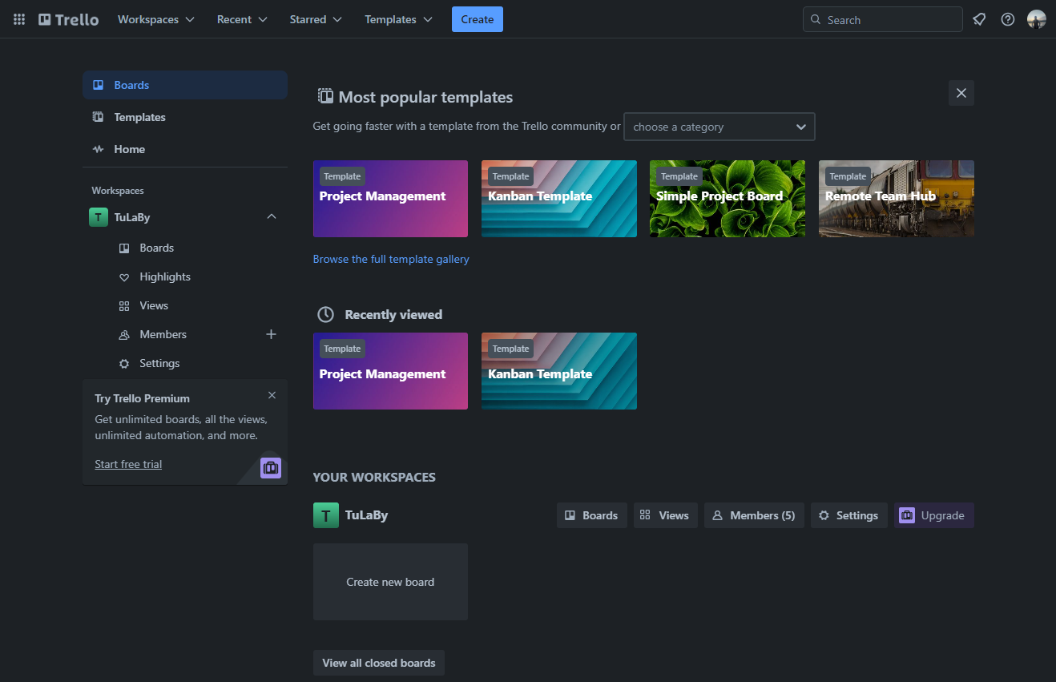

Slide 31


Tools

Slide 32


Flutter
Figma

Slide 33


Vs code
Android Studio

Slide 34


React

Slide 35
Conclusion
TuLaBy is an intricately designed platform tailored for various stakeholders in academic institutions, encompassing students, professors, teaching assistants, and administrators. It offers a spectrum of advantages:
Students can effortlessly log attendance, access personal educational data, view schedules, and monitor grades.
Professors benefit from streamlined attendance oversight, insightful analytics, and efficient grade finalization.
Teaching assistants adeptly manage lab attendance and associated attributes.
Administrators relish comprehensive oversight over users, subjects, and announcements.
TuLaBy furnishes a seamless experience across both web and mobile platforms, prioritizing accessibility and user-friendliness. It is engineered with a flexible architecture for future refinements while upholding precision, quality, and adaptability in academic administration.

Slide 36
THANK YOU
FOR LISTENING!

